Slide 1


AMERICAN INTERNATIONAL UNIVERSITY–BANGLADESH (AIUB)
FACULTY OF SCIENCE & TECHNOLOGY
DEPARTMENT OF CSE
Summer 2023-2024
Section: C, Group:
Faysal Ahmmed Asef Rahman Antik Md. Mirazul Hasan Most. Sayma Khatun
22-47069-1 22-47106-1 22-46674-1 22-47035-1

Slide 2

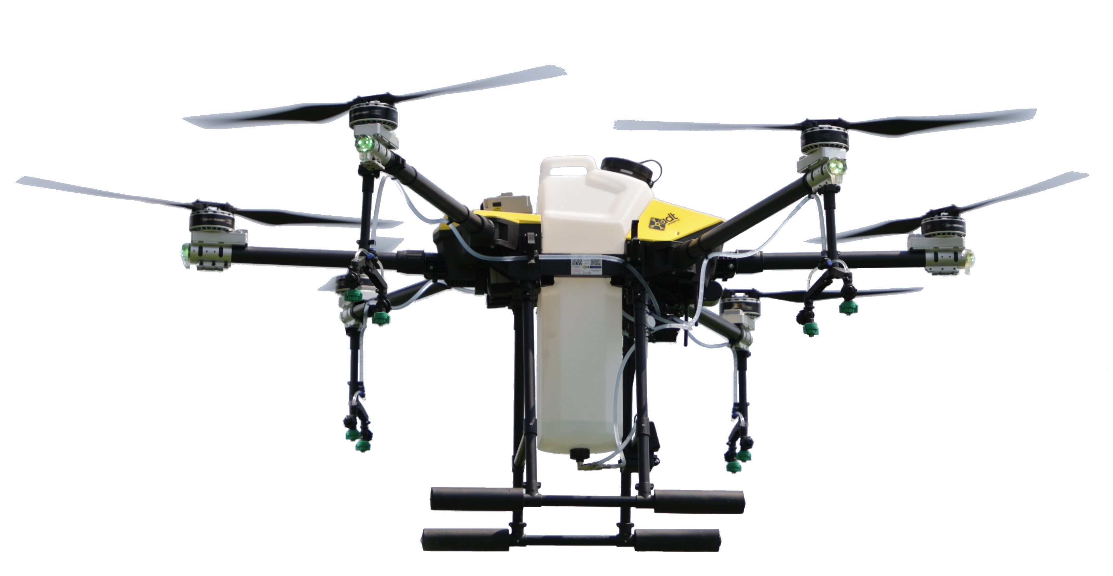
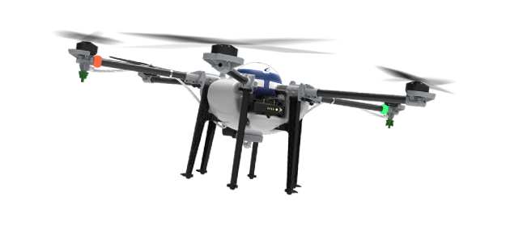

Identifying and Overcoming Barriers to the Adoption of
Drone-Based Pesticide Systems for Small and Medium-Sized Farms

Slide 3
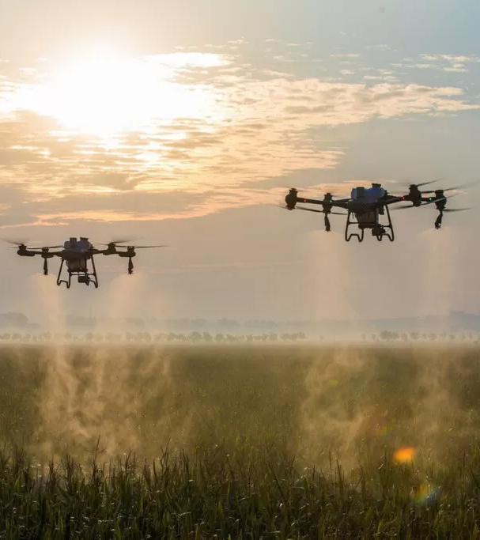
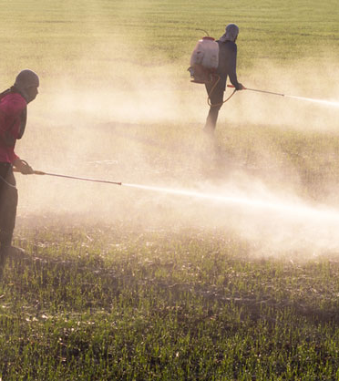
Done Based Pesticide Traditional Pesticide
Aspect | Drone-Based Systems | Traditional Methods
Precision & Accuracy | High precision, reduced waste | Less precise, higher waste
Efficiency | Fast, real-time monitoring | Slow, labor-intensive
Environmental Impact | Minimal contamination | Higher risk of drift/runoff
Cost | High initial cost, long-term savings | Lower initial cost, higher long-term costs
Adoption Barriers | Training, regulations, initial cost | Easier to implement
Technological Integration | Integrates with smart farming tech | Limited integration
VS

Slide 4
Done Based Pesticide Traditional Pesticide
VS
Aspect | Drone-Based Systems | Traditional Methods
Precision & Accuracy | High precision, reduced waste | Less precise, higher waste
Efficiency | Fast, real-time monitoring | Slow, labor-intensive
Environmental Impact | Minimal contamination | Higher risk of pesticide drift or runoff.
Cost | High initial cost, long-term savings | Lower initial cost, higher long-term costs
Adoption Barriers | Training, regulations, initial cost | Easier to implement
Technological Integration | Integrates with smart farming tech | Limited integration

Slide 5
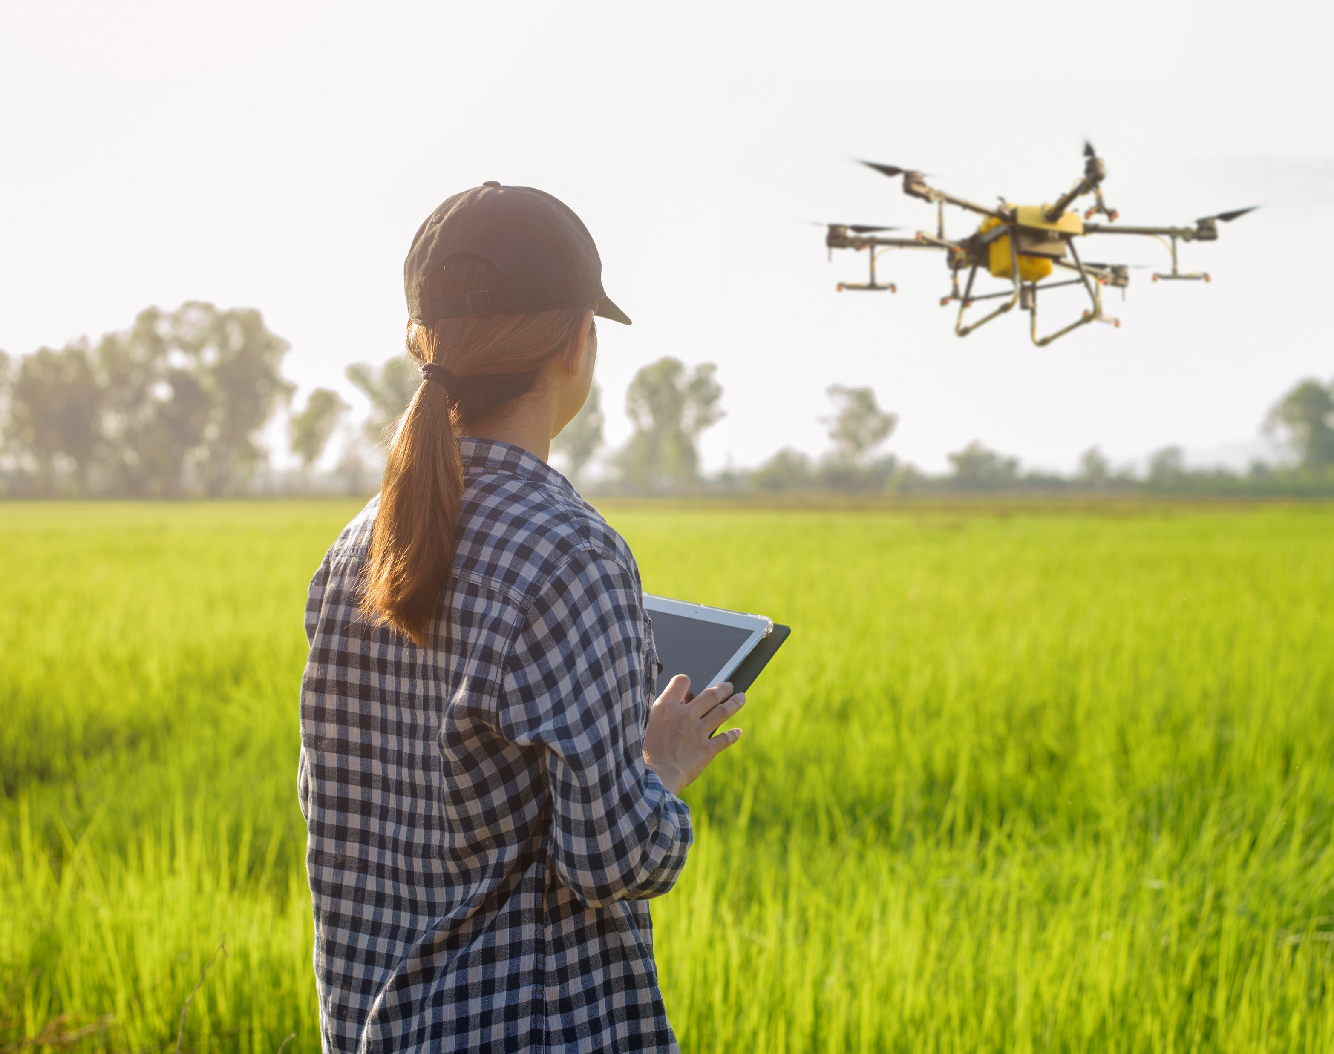
Research Question and Objectives
Primary Research Question
What are some ways to make it easier for small and medium-sized farms to adopt drone-based pesticide systems?
Specific Aims/Objectives
To understand the economic barriers that small to medium-sized farmers face in adopting drone-based pesticide systems.
To describe the challenges associated with the use of UAVs in agriculture and propose potential solutions.
To investigate the effectiveness of training programs in enhancing the skills required for operating drone-based pesticide systems.

Slide 6
Research Methodology Selection
Agile Method- Research Structure
Requirements Gathering
Iteration Planning
Development
Testing and Feedback
Review and Retrospective
Mixed Method- Data Collection
Survey
Interview
Case Studies

Slide 7
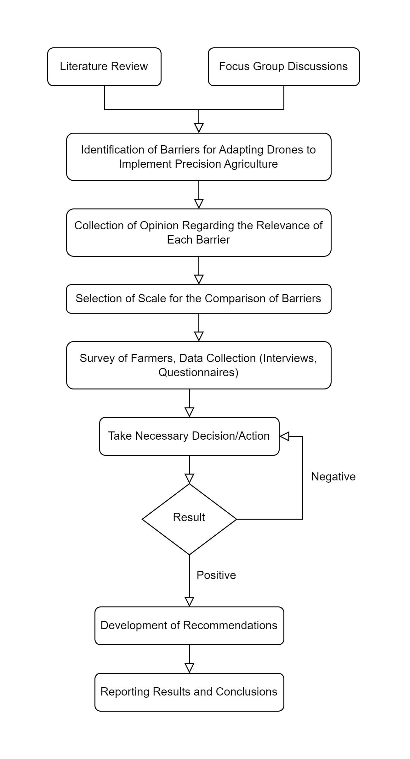
Flowchart of the
Research Methodology

Slide 8
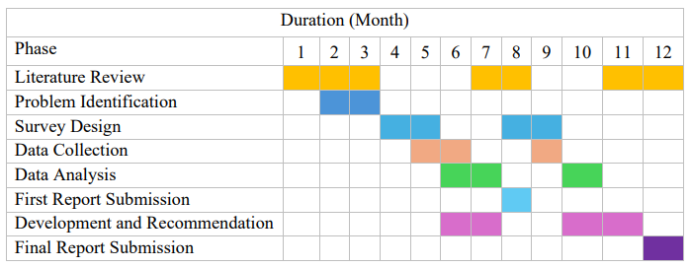
Schedule

Slide 10
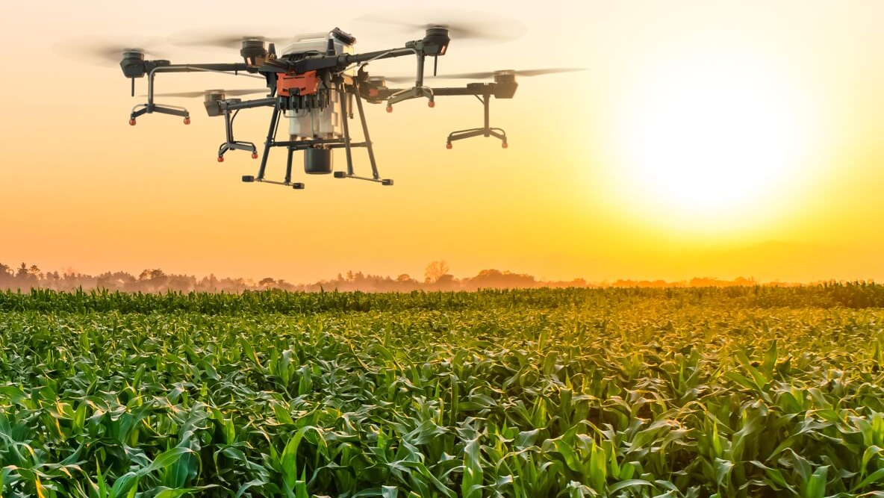
Conclusion
Researching drone-based pesticide systems using agile method will benefit requirement changing, replicable results and hypothesis validation through controlled experiments.
The mixed-methods approach will integrate quantitative data with qualitative insights to comprehensively address adoption barriers, enhancing decision-making, policies, training, and adoption strategies for sustainable agricultural practices.

Slide 11

Thank you for your patience

